Slide 1
Unlocking Data Insights
An Introduction to Power BI
S. RIYASDEEN
Assistant Professor of Mathematics,
Khadir Mohideen College,
Adirampattinam
29.07.2025
@ M.O.P. Vaishnav College for Women, Chennai

Slide 2
AGENDA
1
What is Data?
6
Installing Power BI Desktop
2
Types of Data
7
Getting Data into Power BI
3
What is Business Intelligence (BI)?
8
Loading and Transforming Data
4
Why Do We Need BI Tools?
9
Creating Calculated Columns
5
Introducing Power BI
10
Designing a Dashboard

Slide 3
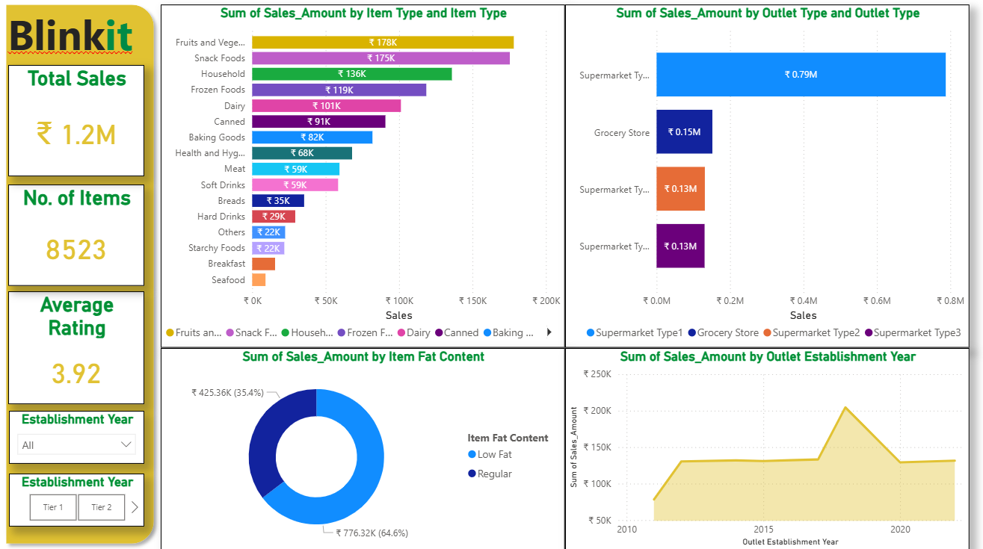
Blinkit sales analysis Dashboard

Slide 4
What is Data?
At its core, data is raw information – facts, figures, or symbols – that we collect to analyze, reference, and use for decision-making.
Raw Data (Unprocessed) vs Processed Data
Think of this as unprocessed information, like individual sales figures, customer names, or sensor readings, waiting to be organized.
This is data that has been organized, analyzed, and transformed into valuable insights, such as monthly sales trends or customer demographics.

Slide 5
Types of Data
Structured Data
Highly organized and easily searchable data, typically found in relational databases (like SQL tables) with predefined formats.
Examples: Customer names in a spreadsheet, transaction dates.
Unstructured Data
Information that doesn't fit into a predefined data model, making it harder to process and analyze.
Examples: Emails, social media posts, audio recordings, images, video files.
Semi-structured Data
A hybrid of both, it has some organizational properties but doesn't conform to a strict relational database structure.
Examples: XML files, JSON documents, web pages.

Slide 6
What is Business Intelligence (BI)?
Business Intelligence transforms vast amounts of raw data into actionable insights, helping organizations make informed decisions.
Data Mining
Discovering patterns and trends in large datasets.
Data Warehousing
Centralizing and storing data for reporting and analysis.
Data Analytics
Examining data to draw conclusions.
Dashboards
Visualizing key performance indicators for quick insights.

Slide 7



Why Do We Need BI Tools?
Overcoming Data Overload
Unstructured data is dispersed globally, making it difficult for companies to handle and monitor.
Driving Quick Decisions
Powerful BI tools enable rapid, data-driven decisions to boost sales and operational efficiency.
Enhancing Operations
They increase structured data availability, generate comprehensive reports, manage customers, and track employee performance.

Slide 8
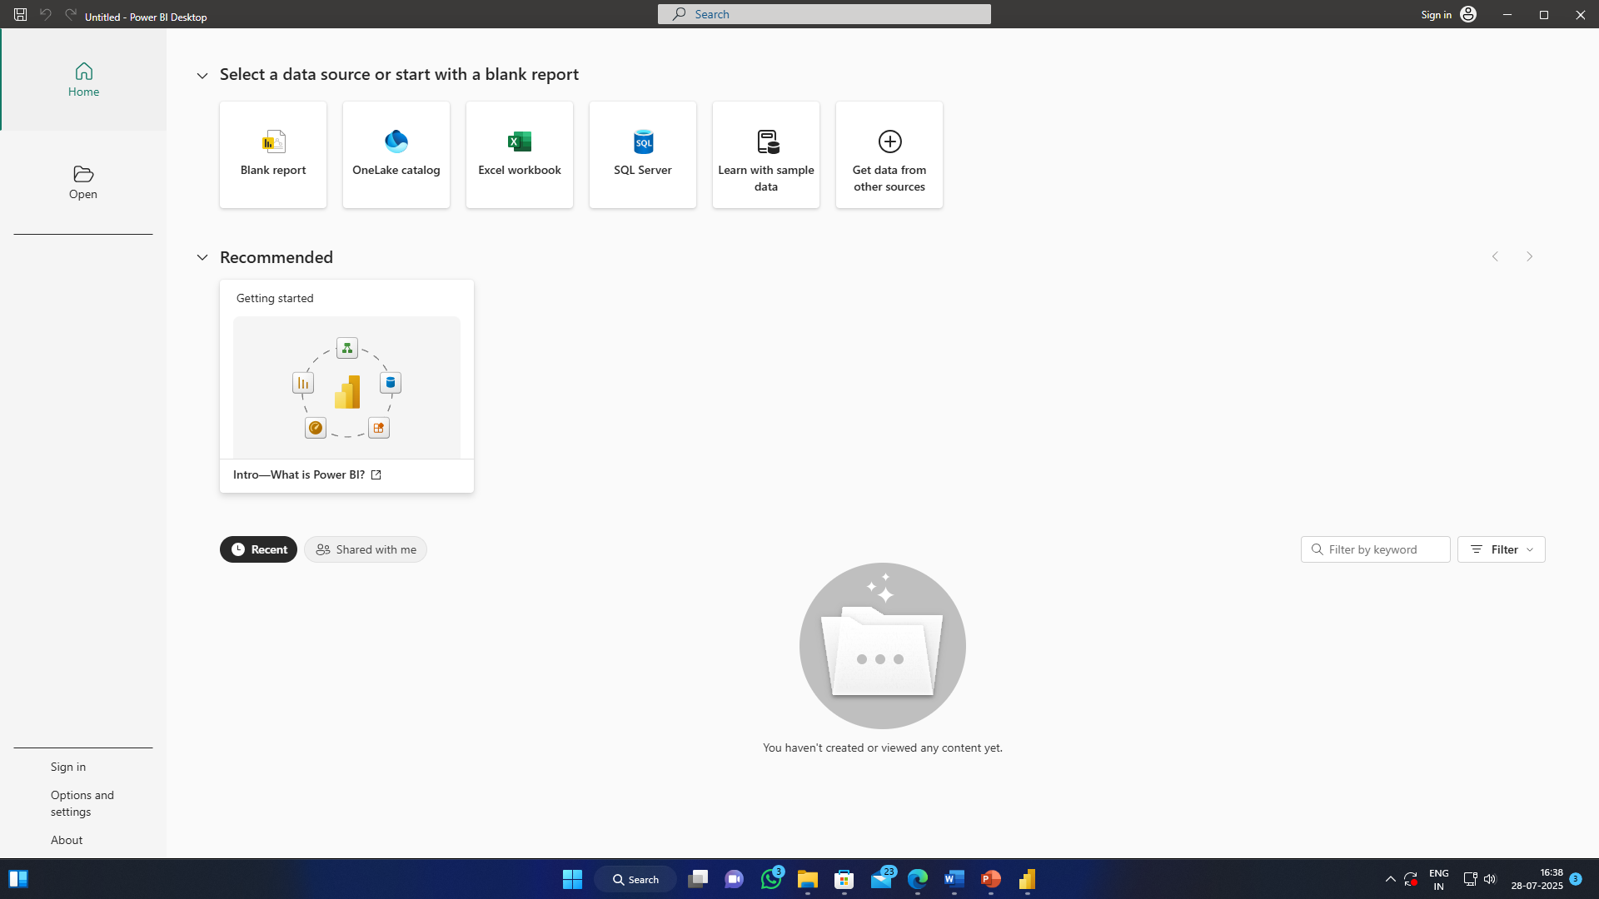
Introducing Power BI
Power BI is a leading Business Intelligence tool for data visualization, transforming disparate data sources into interactive dashboards and reports.
Converts raw data into interactive dashboards.
Empowers business users to build and consume BI reports.
Used for creating dynamic reports and data visualizations.
It allows users to explore data visually and gain insights quickly.

Slide 9
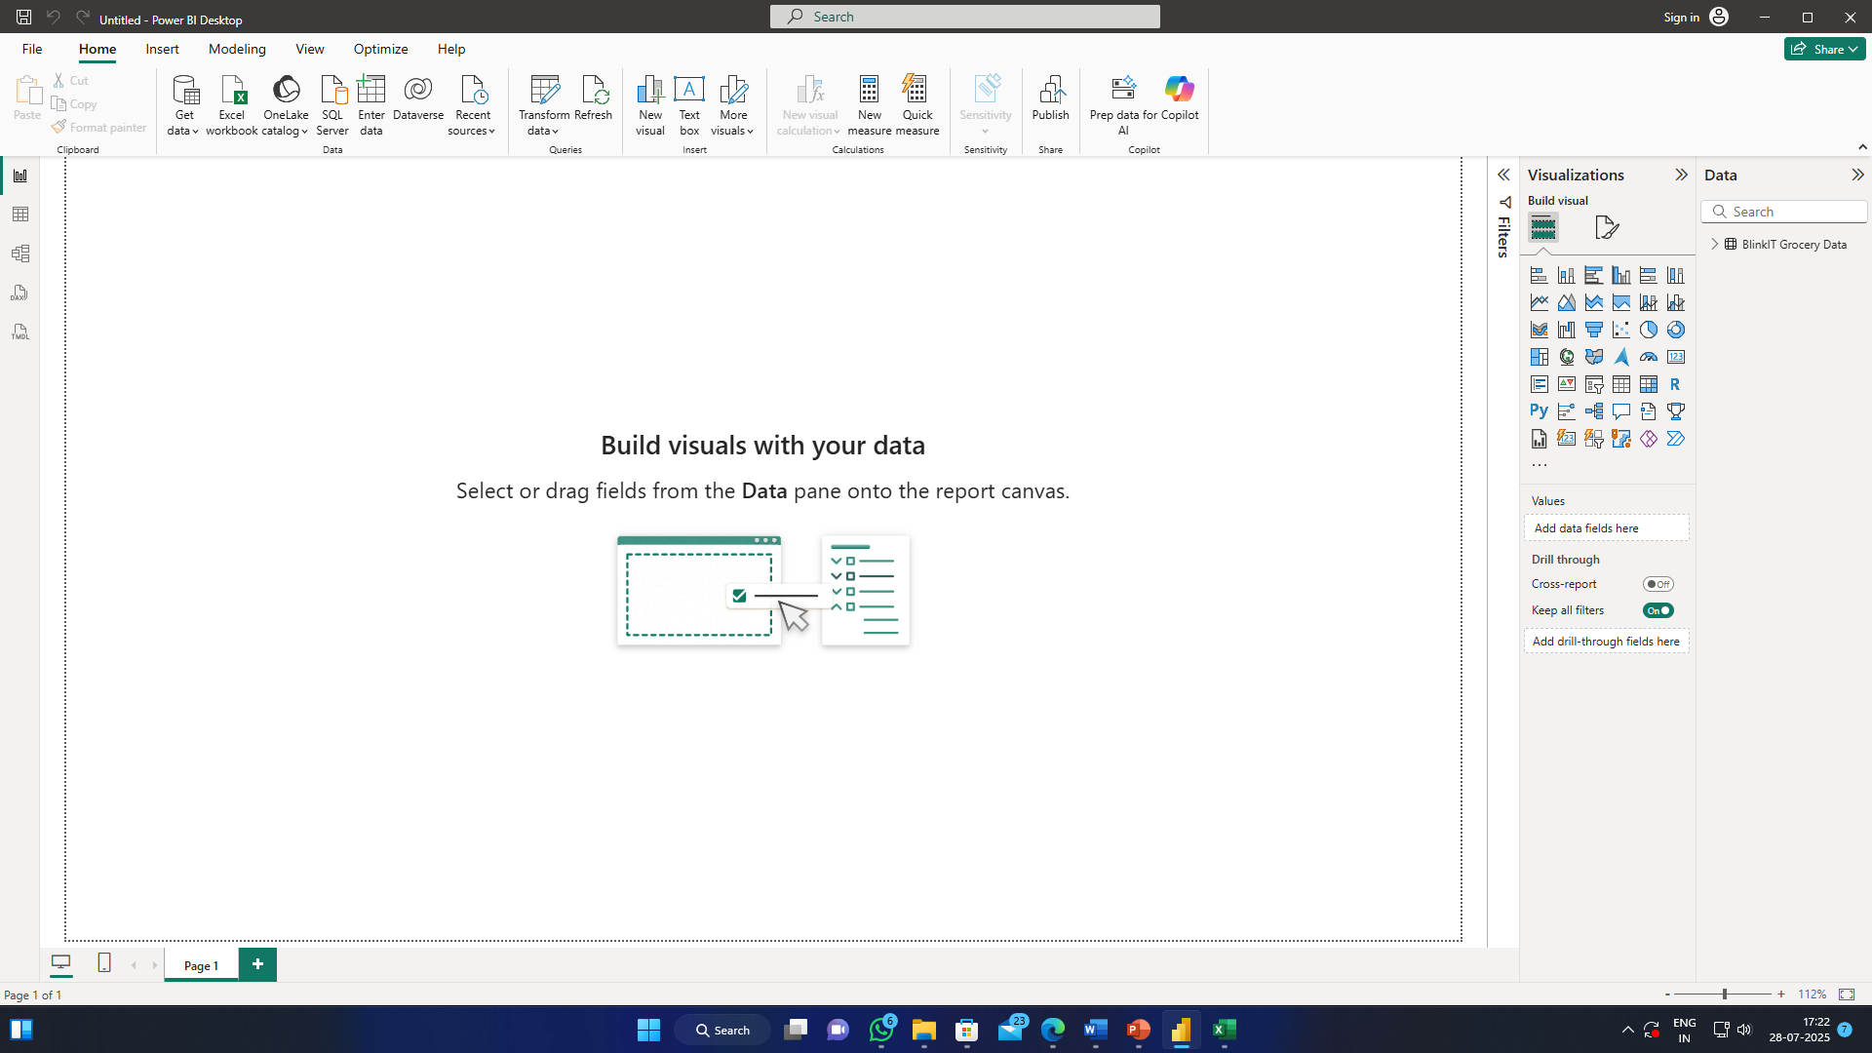
Introducing Power BI
Ribbon (Top Menu Bar)
Home: Get Data, Transform Data, Refresh, Enter Data, Publish
Insert: Add visuals, buttons, text boxes, shapes, etc.
Modeling: Define relationships, change data types, and create measures/ columns.
View: Adjust layout, themes, and formatting.
Optimize / Help – For performance tuning and assistance.

Slide 10
Introducing Power BI
Report Canvas (Center Area)
This is the main workspace where you drag visuals and build dashboards.
It’s prompting you to drag fields from the Data pane to start creating visuals.
Data Pane (Right Sidebar –Bottom)
This is where all your tables and fields (columns) live.
You’ll drag these fields into the report canvas or visual fields to create visuals.

Slide 11
Introducing Power BI
Visualizations Pane (Right Sidebar – Top)
Shows all available visual types: bar chart, line chart, pie chart, table, matrix, map, etc.
Also contains field wells like: Values, Axis, Legend, Tooltips.
You can customize visuals here.
Left Navigation Pane
There are three icons:
Report View
Data View
Model View

Slide 12
Introducing Power BI
Filters Pane (Middle Right – collapsible)
This pane lets you add filters: Report-level, Page-level, Visual-level.
Useful for narrowing down data shown in visuals.

Slide 13
Installing Power BI Desktop
Get started with Power BI by following these simple installation steps on Windows.
Step 1: Download Power BI
Visit the official Microsoft Power BI Desktop download page: Link
Step 2: Advanced Download
Click "Advanced download options," select your preferred language (e.g., English), and click "Download."
Step 3: Run Installer
Once downloaded, locate the executable file in your Downloads folder and run it.
Step 4: Installation Wizard
Follow the on-screen prompts, click "Next," accept the license agreement, and continue until you reach the "Install" button.
Step 5: Complete Setup
Click "Install" to begin, and then "Finish" once the installation is successfully completed.

Slide 14
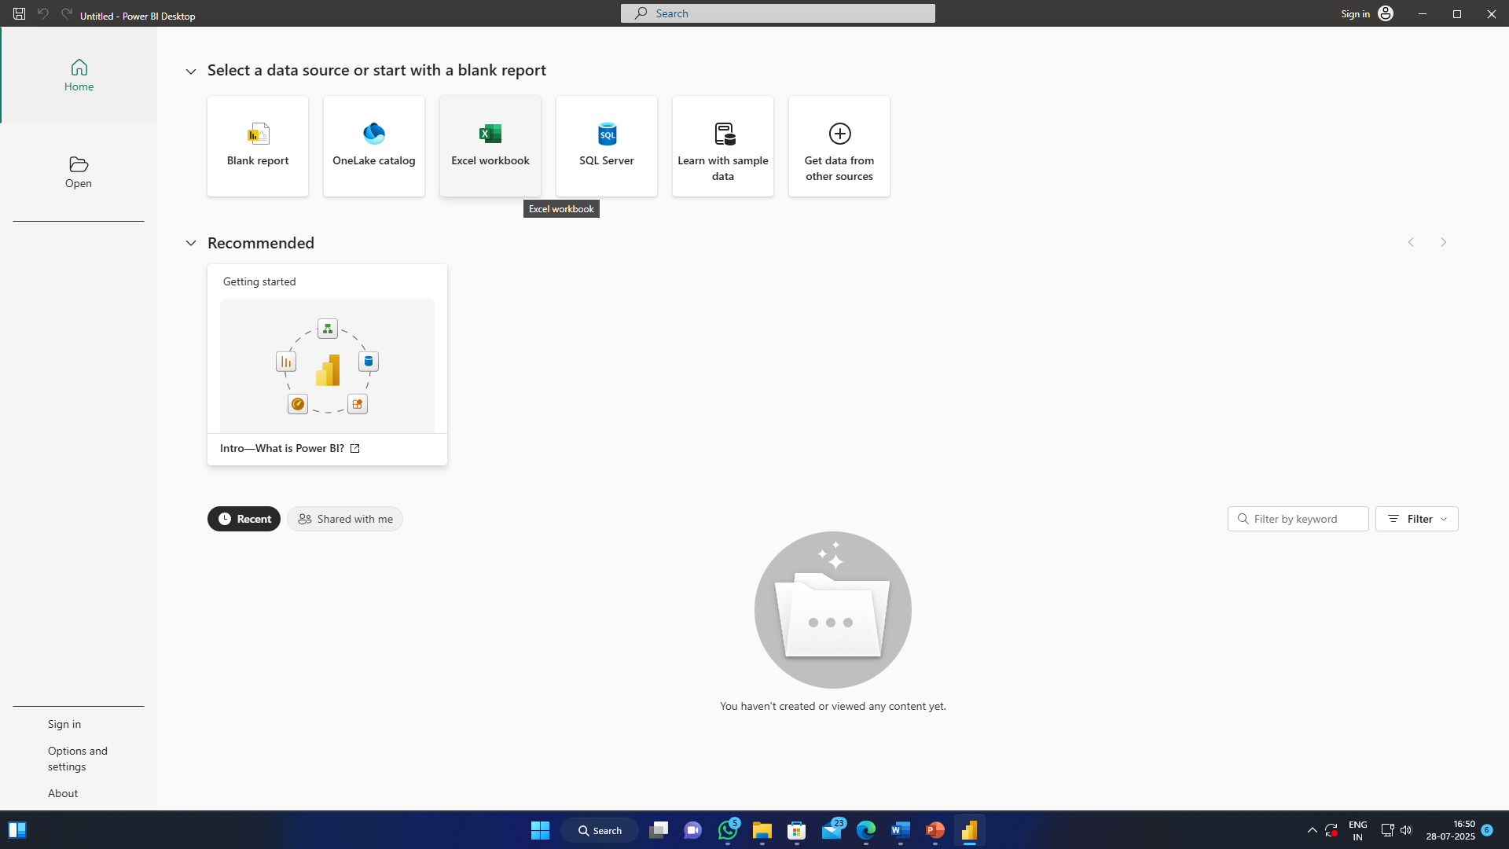
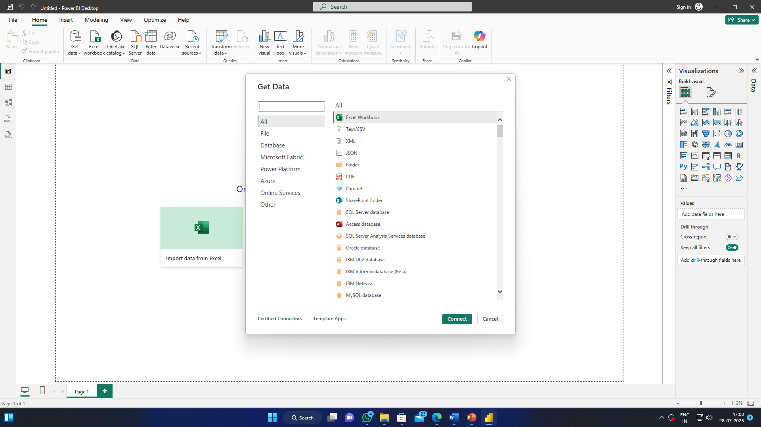
Getting Data into Power BI
Power BI offers diverse options to connect to your data sources, whether they are local files or cloud services.
Clicking "Get Data" allows you to connect to various sources.
Choose from options like Azure, Microsoft Fabric, local files (e.g., Excel), or databases to meet your business needs.
This step is crucial for bringing your raw information into Power BI for transformation and visualization.
We are using: BlinkIT Grocery Data.xlsx for this project

Slide 15
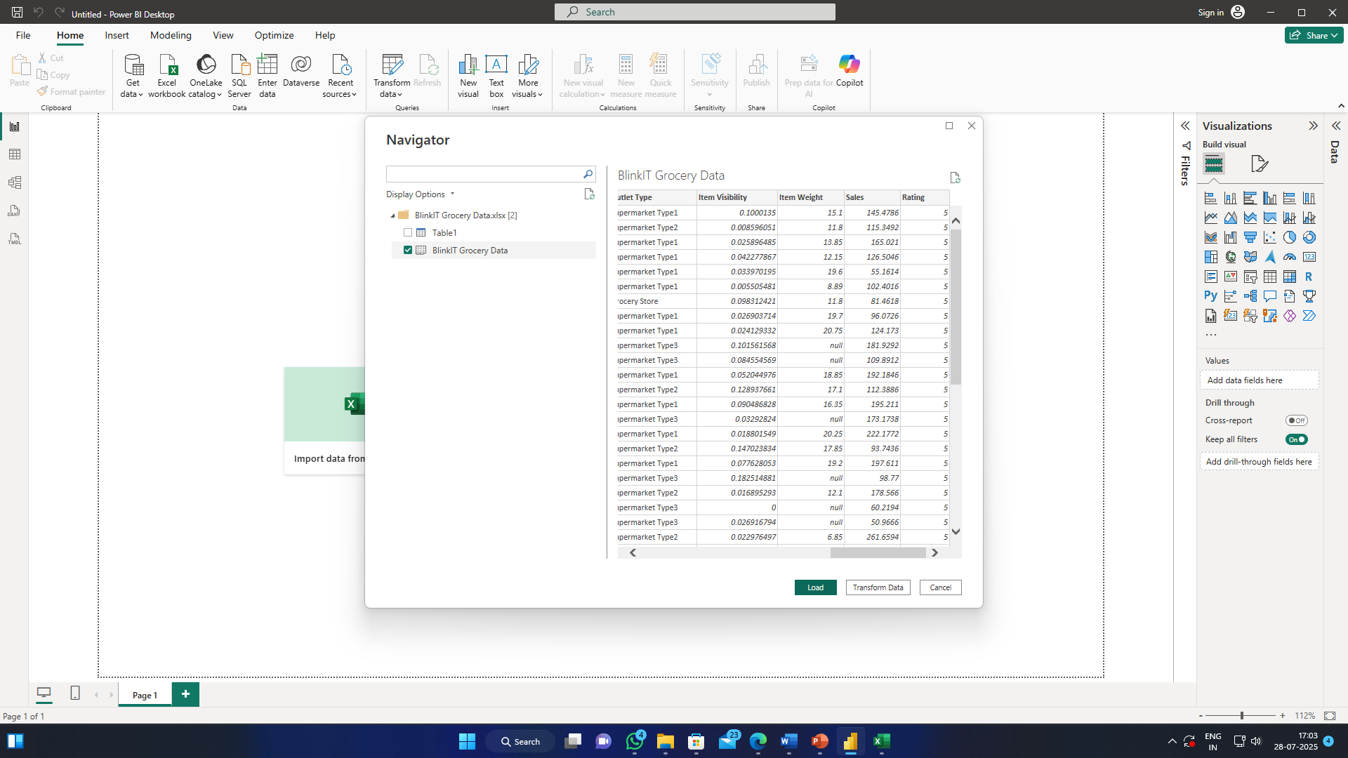
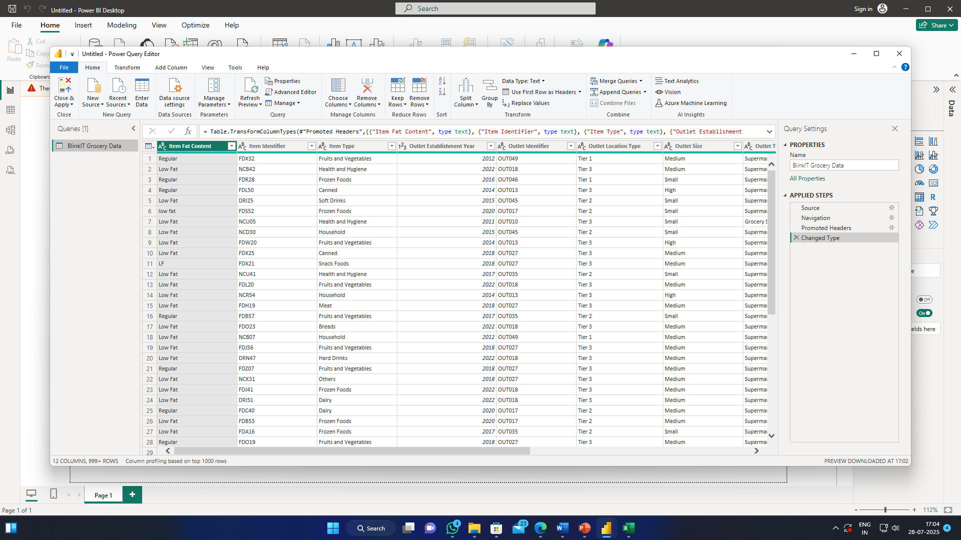
Loading and transforming data

Slide 16
Loading and transforming data
Remove unnecessary columns: e.g., Item Identifier ID not required) [Right Click → Remove Column]
Rename fields for clarity (e.g., rename Sales to Sales_Amount) [Right Click → Rename]
Change data types for correctness:
Change Abbreviations to full forms (Lf → Low Fat, etc.).
Item Visibility → Decimal Number
Sales → Currency (Fixed Decimal Number)
Check Column Quality (View → Column Quality)
Filter out nulls and errors in important columns
Click Close & Apply to save changes

Slide 17
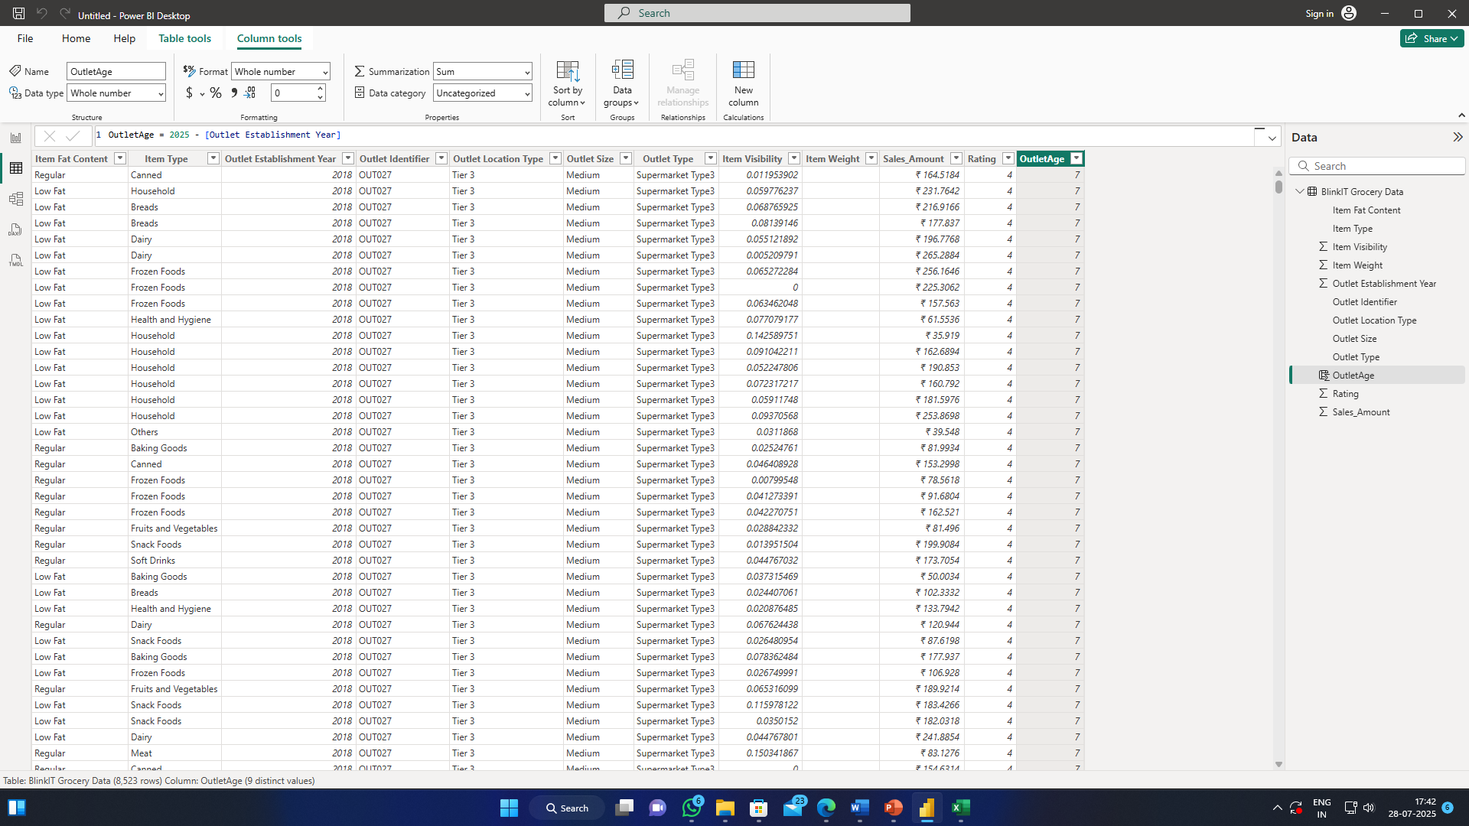
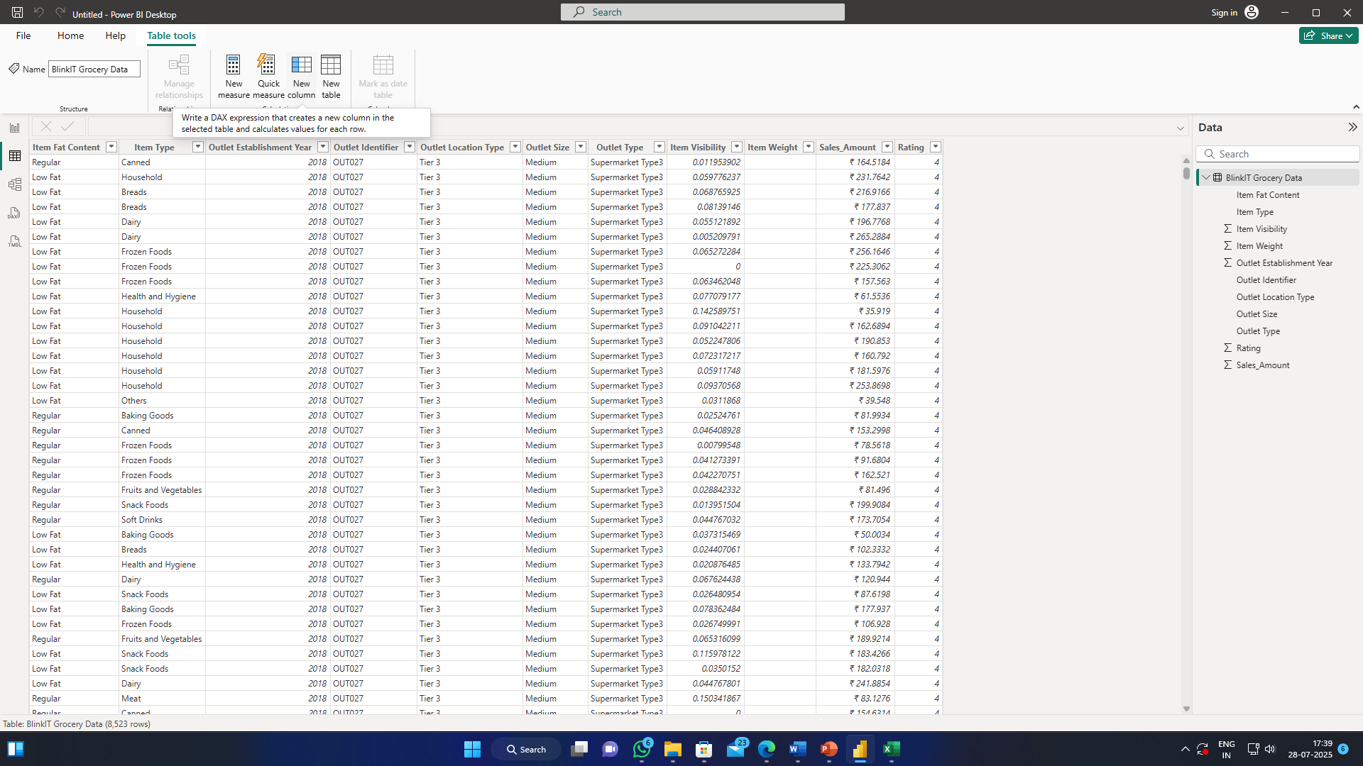
Creating Calculated Columns
Switch to Data view in Power BI Desktop
Go to Modeling → New Column
Example:
OutletAge = 2025 - [Outlet Establishment Year]

Slide 18
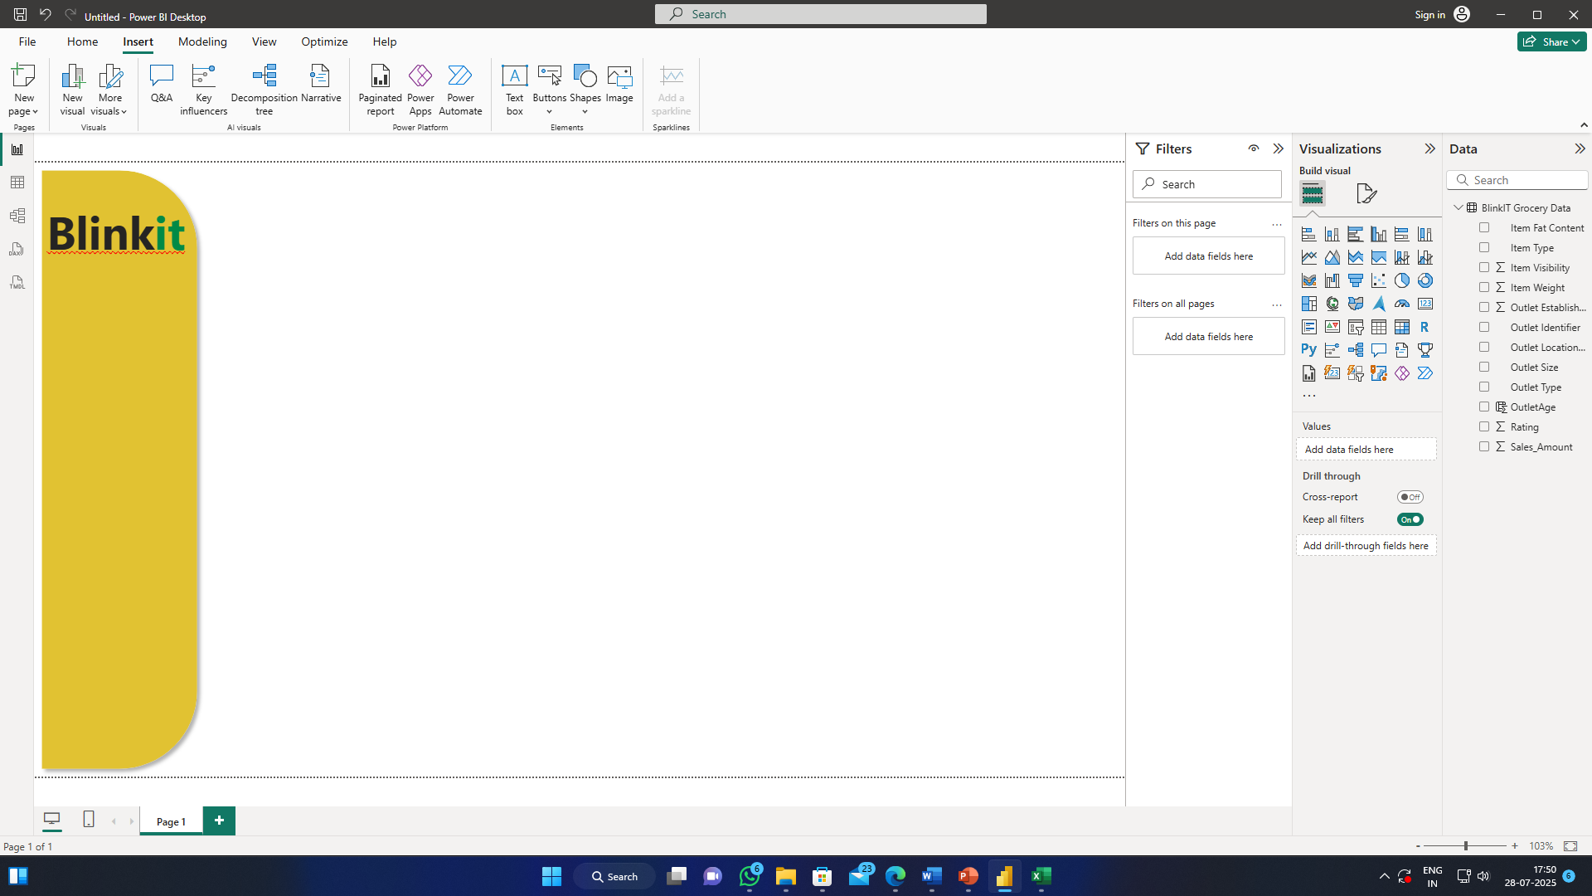
Designing dashboard
Add Title and Colors

Slide 19
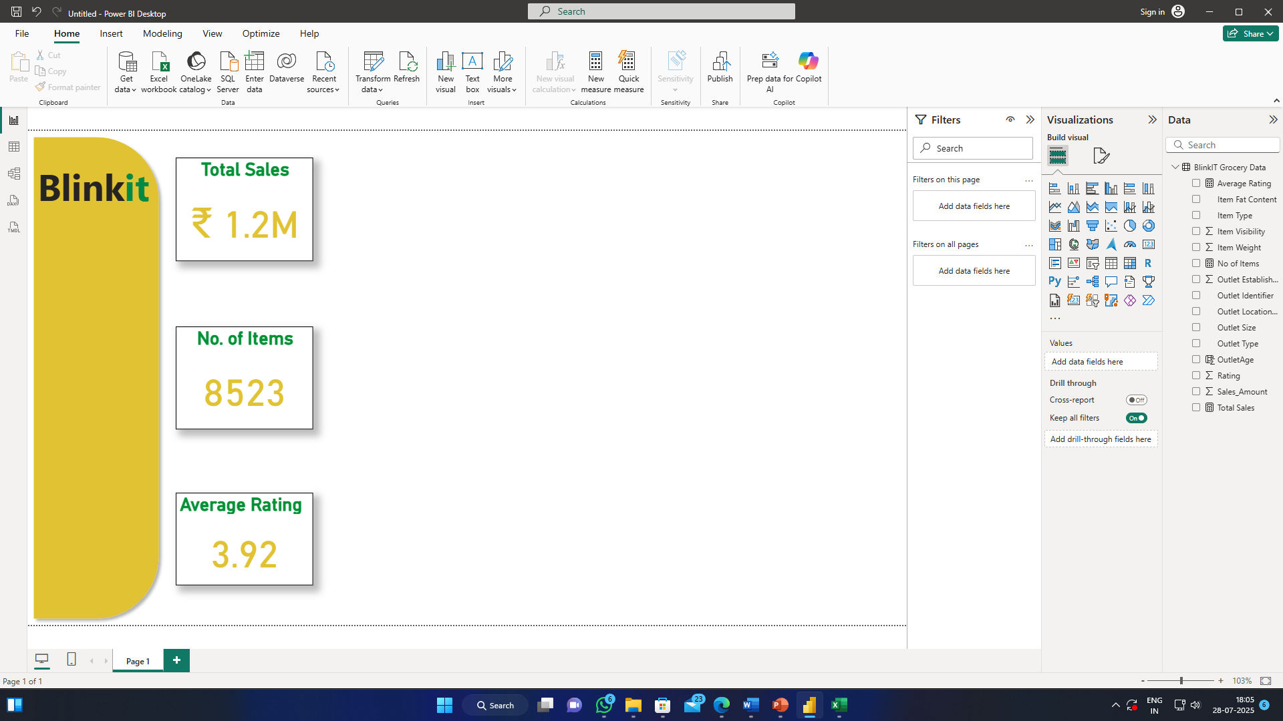
Create KEY PERFORMANCE INDICATORS (kpi’s)
Create New Measures
Total Sales: SUM(Sales)
Average Rating: AVERAGE(Ratings)
Count of Items: COUNTROWS(Data)
Create Cards:
Double Cards from Visualizations
Drag: Total Sales, Average Rating, Count of Items
Change Colors

Slide 20
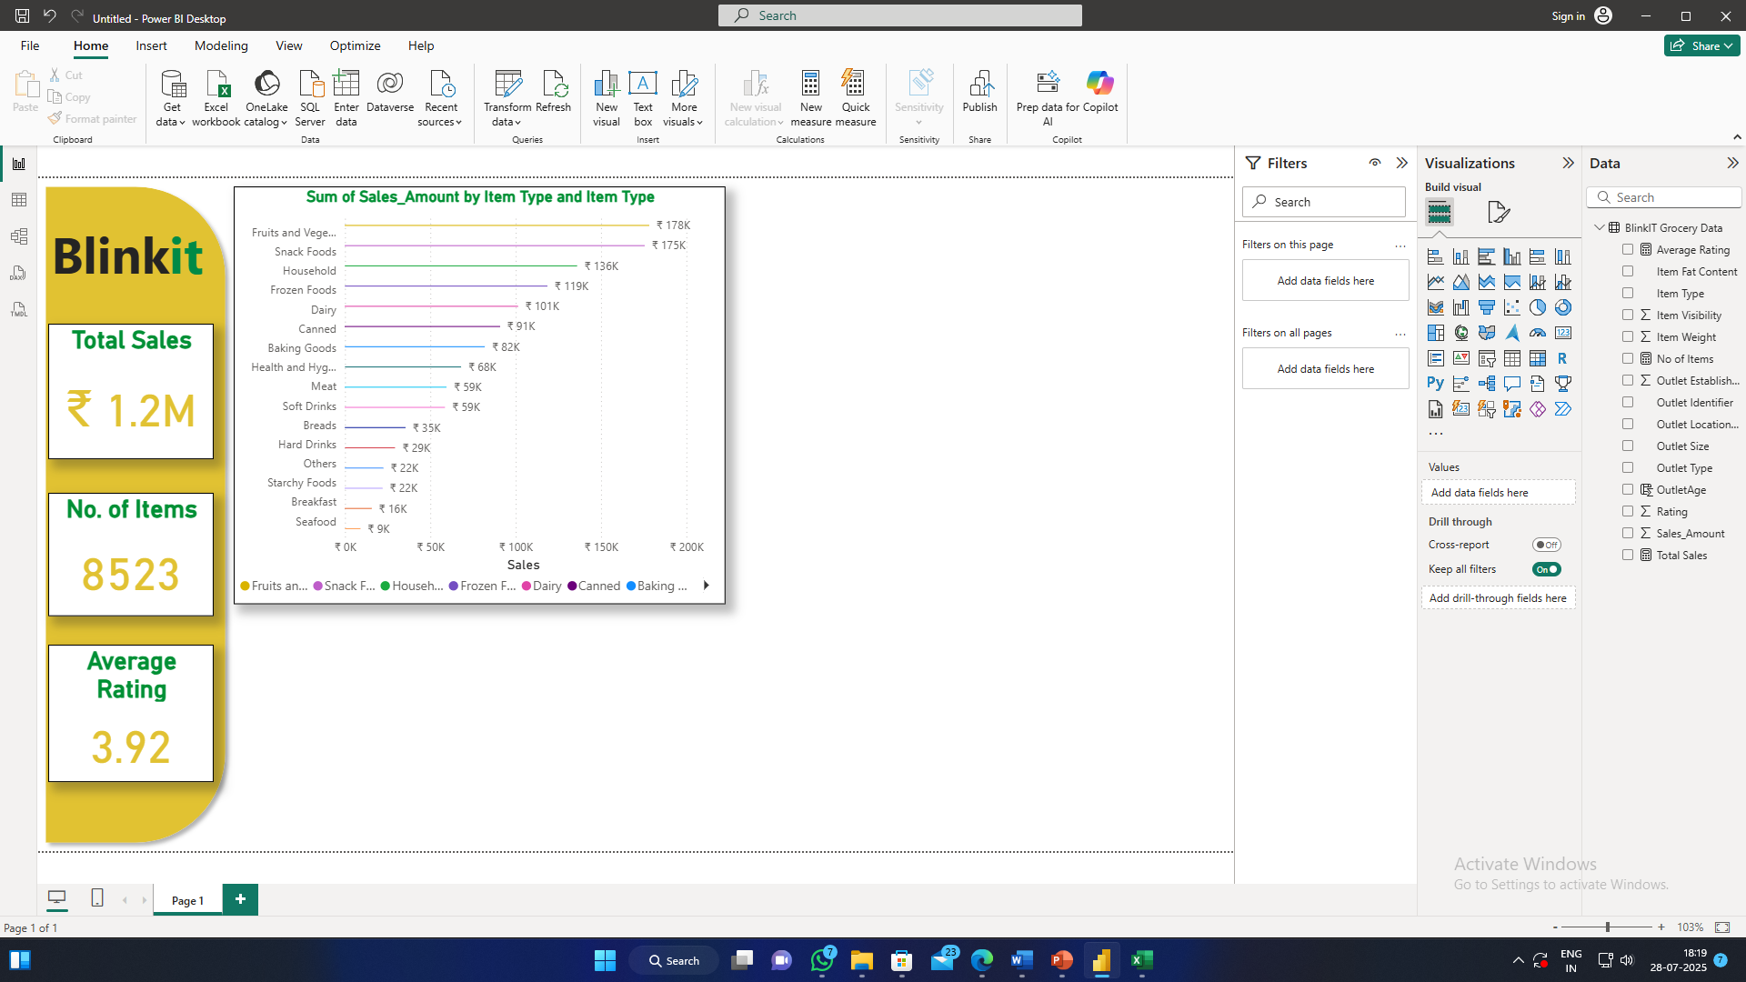
Sales by item type
Insert a Stacked Bar Chart
Item Type as Y-axis
Sales Amount as X-axis
Item Type as Legend
Change Colors and Designs

Slide 21
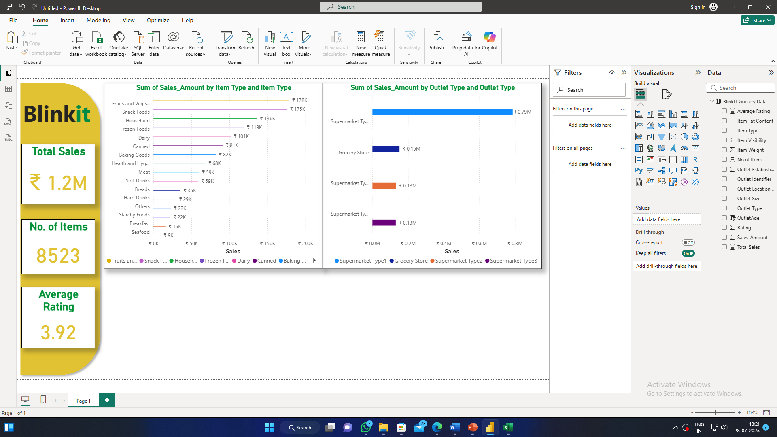
Sales by OUTLET type
Insert a Stacked Bar Chart
Outlet Type as Y-axis
Sales Amount as X-axis
Outlet Type as Legend
Change Colors and Designs

Slide 22
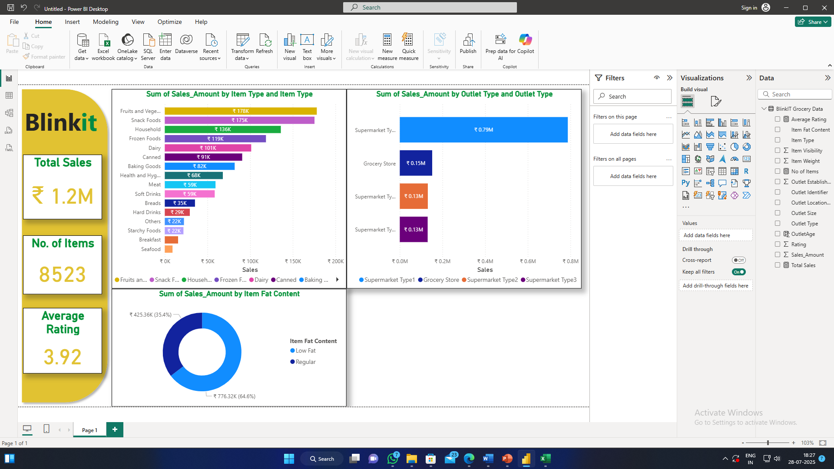
Sales by FAT CONTENT
Insert a Donut Chart
Sales Amount as Values
Fat Content Item as Legend
Change Colors and Designs

Slide 23
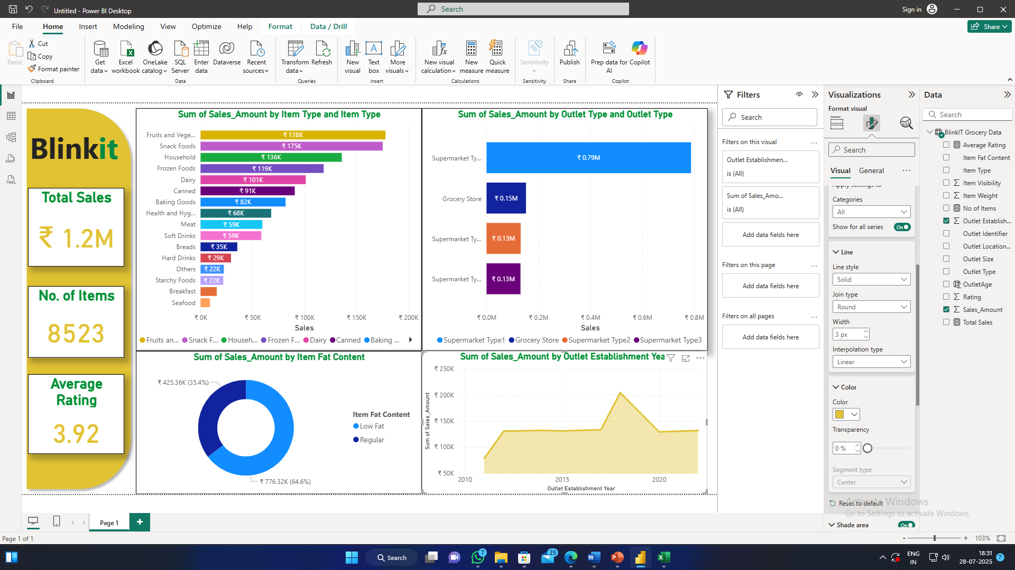
Sales by outlet establishment
Insert a Line Chart
Outlet Establishment as X-axis
Sales Amount as Y-axis
Outlet Type as Legend
Tick Shade Area
Change Colors and Designs

Slide 24
MORE CHARTS
Sales by Outlet Size
Sales by Outlet Location
Total Comparison Table
And more…

Slide 25

Creating slicer
Insert a Slicer
Outlet Establishment as Field or
Outlet Location as Field
Change Colors and Designs
Change options of Slicers too
You can do for Item Type, Outlet Type, Size, etc.

Slide 26
Thank you
Email: riyasafrim@kmc.edu.in
Website: www.kalvikraft.in

